Slide 1
Synchronous Counters
With MSI Gates
Digital Electronics
© 2014 Project Lead The Way, Inc.

Slide 2
Synchronous MSI Counter
This presentation will
Introduce the 74LS163 Synchronous 4-Bit Binary Up Counter.
Review the 74LS163’s connection diagrams, signal descriptions, logic and timing diagrams.
Provide an examples of a counter application implemented with the 74LS163.
Introduce the 74LS193 Synchronous 4-Bit Binary Up/Down Counter.
Review the 74LS193’s connection diagrams, signal descriptions, logic and timing diagrams.
Provide an examples of a counter application implemented with the 74LS193.
Notes:
Introductory Slide / Overview of Presentation

Slide 3
74LS163 Synchronous Binary Up Counter
Four Bit Synchronous Up Counting.
Pre-loadable Count Start
Synchronous Load
Synchronous Clear
Two Count Enable Inputs
Carry-Out Signal for Counter Cascading
Notes:
Summary of 74LS163 Feature Set.

Slide 4
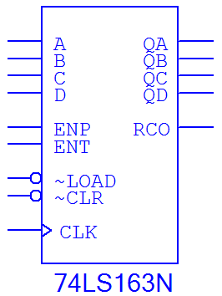
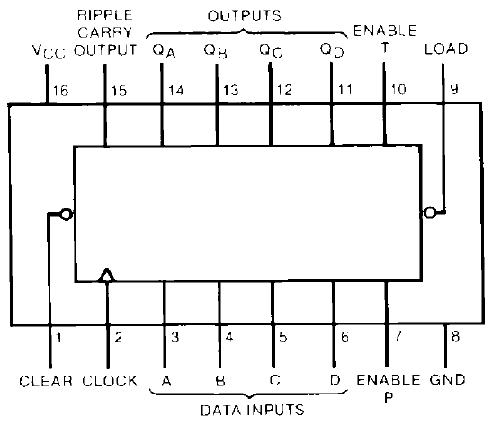
74LS163 Component Diagram
74LS163
Component Diagram
From CDS
74LS163
Connection Diagram
From Datasheet
Notes:
74LS163 connection diagrams from circuit design software and manufacturer’s datasheet.

Slide 5
74LS163 Signal Descriptions (1 of 2)
Signal Name:
A : Data Input (LSB)
B : Data Input
C : Data Input
D : Data Input (MSB)
QA : Data Output (LSB)
QB : Data Output
QC : Data Output
QD : Data Output (MSB)
Notes:
74LS163 signal descriptions
A, B, C, D : Are the data inputs, this is the data that can be load into the counter. This is how the lower limit of the count is set.
QA, QB, QC, QD : Are the data outputs. This is the count of the counter.

Slide 6
74LS163 Signal Descriptions (2 of 2)
Signal Name:
ENP : Count Enable P
ENT : Count Enable T
LOAD : Data Load
CLEAR : Clears The Counter
CLOCK : Clock Input
RCO : Ripple Carry Out
Notes:
74LS163 signal descriptions
ENP & ENT : These are enable inputs. They both need to be a logic (1) for the counter to be enabled. For most free running counters, these input will be tied high.
LOAD : This is the load input. When this input is a logic (0), the data on the Data Input lines is loaded into the counter. Note, LOAD is a synchronous input. Thus, the Data Input will be loaded into the counter on the next rising edge of the clock when the LOAD input is a logic (0).
CLEAR : This is the clear input. When this input is a logic (0), and the counter is disabled, the counter will be cleared. Another words, you can’t clear an enabled counter. The counter must first be disabled, then cleared.
CLOCK : This is the clock input. It is a positive edge trigger clock.
RCO : This is the Ripple Carry Output. This output is a logic (1) when the counter is at it upper limit (1111). This signal is typically used to when the multiple counters are cascaded.

Slide 7
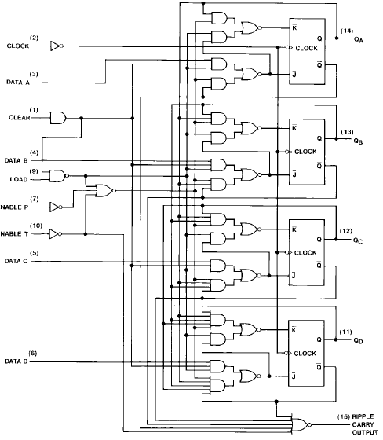
74LS163 Logic Diagram
Notes:
74LS163 logic diagrams from manufacturer’s datasheet. The students are not responsible for this material, but it is here just as a reference to show them the complexity of this MSI counter. Also, point out the all the clocks are tied together, that is why this is a synchronous counter design.

Slide 8
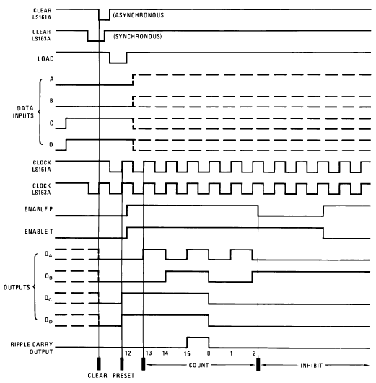
74LS163 Timing Diagram (1 of 3)
CLEAR set to a logic (0); Outputs are cleared on next rising edge of clock.
LOAD set to a logic (0); Outputs are loaded with input data on next rising edge of clock. In this example a 12 (1100) is loaded.
A
B
Notes:
Shown is the composite timing diagram for the 74LS163 & 74LS161 counter. Since we will only be discussing the 74LS163 the two waveform on the diagram the are for the 74LS161 can be ignored.

Slide 9
74LS163 Timing Diagram (2 of 3)
Counting is enabled; ENT & ENP are both set to a logic (1). On every rising edge of clock, the output count is incremented by one. In this example 12, 13, 14, 15, 0, 1, 2. Note, when the count is 15, RCO is a logic (1) for the full clock cycle .
C
Notes:
Shown is the composite timing diagram for the 74LS163 & 74LS161 counter. Since we will only be discussing the 74LS163 the two waveform on the diagram the are for the 74LS161 can be ignored.

Slide 10
74LS163 Timing Diagram (3 of 3)
ENP set to a logic (0); Counting is disabled.
ENT set to a logic (0); Counting is disabled.
D
E
Notes:
Shown is the composite timing diagram for the 74LS163 & 74LS161 counter. Since we will only be discussing the 74LS163 the two waveform on the diagram the are for the 74LS161 can be ignored.

Slide 11
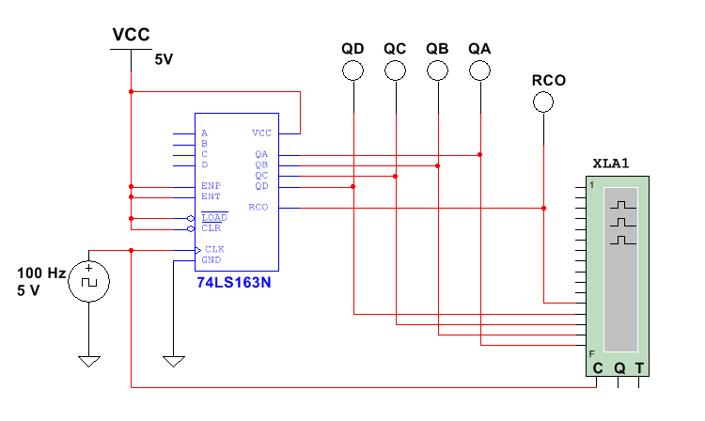
74LS163 Design Example #1
“0”
“1”
“2”
“3”
“4”
“5”
“6”
“7”
“8”
“9”
“A”
“B”
“C”
“D”
“E”
“F”
“0”
Repeats →
RCO
QD
QC
QB
QA
CLK
Notes:
In this example, the 74LS163 is setup as a free running (i.e. no enable & no clear) up counter from 0 to 15. Note that the RCO is high when the count is F=15=1111.

Slide 12
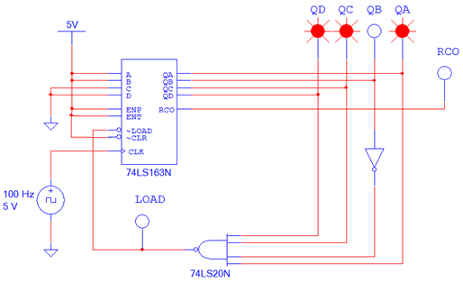
74LS163 Design Example #2
“B”
“C”
“D”
“3”
“4”
“5”
“6”
“7”
“8”
“9”
“A”
“B”
“C”
“D”
“3”
“4”
“5”
Repeats →
RCO
QD
QC
QB
QA
LOAD
CLK
Notes:
In this example, the 74LS163 is setup as a 3 to D (13) up counter. Note, LOAD signal goes low when the count is 1101 (D). Because the LOAD signal is a synchronous input, input data of 3 (0011) is not loaded until the next rising edge of the clock.

Slide 13
74LS193 Synchronous Binary Up/Down Ctr
Four Bit Synchronous Up / Down Counting.
Separate Clock Inputs for Up & Down Counting
Pre-loadable Count Start
Asynchronous Load
Asynchronous Clear
Carry-Out Signal for Counter Cascading Up Counters
Borrow-Out Signal for Counter Cascading Down Counters
Notes:
Summary of 74LS193 Feature Set.

Slide 14
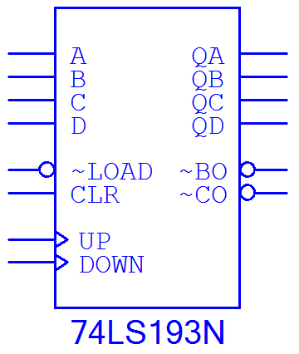
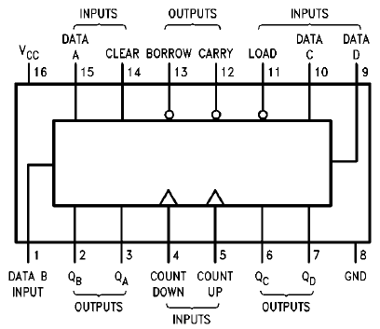
74LS193 Component Diagram
74LS193
Component Diagram
From CDS
74LS193
Connection Diagram
From Datasheet
Notes:
74LS193 connection diagrams from circuit design software and manufacturer’s datasheet.

Slide 15
74LS193 Signal Descriptions (1 of 2)
Signal Name:
A : Data Input (LSB)
B : Data Input
C : Data Input
D : Data Input (MSB)
QA : Data Output (LSB)
QB : Data Output
QC : Data Output
QD : Data Output (MSB)
Notes:
74LS193 signal descriptions
A, B, C, D : Are the data inputs, this is the data that can be load into the counter. This is how the up/lower limit of the count is set.
QA, QB, QC, QD : Are the data outputs. This is the count of the counter.

Slide 16
74LS193 Signal Descriptions (2 of 2)
Signal Name:
UP : Up Counter Clock Input
DOWN : Down Counter Clock Input
~LOAD : Data Load
CLR : Clears The Counter
~BO : Borrow Output
~CO : Carry Output
Notes:
74LS193 signal descriptions
UP : This is the clock input for the up counter. DOWN must be held at a logic (1).
DOWN : This is the clock input for the down counter. UP must be held at a logic (1).
LOAD : This is the load input. When this input is a logic (0), the data on the Data Input lines is loaded into the counter. Note, LOAD is an asynchronous input. Thus, the Data Input will be loaded immediately.
CLR : This is the clear input. When this input is a logic (1), the counter will be cleared. Note, CLR is an asynchronous input. Thus, the Data Output will be cleared immediately.
CO : This is the Carry Output. This output is a logic (0) when the counter is at it upper limit (1111) when the counter is an up counter. This signal is typically used to when the multiple counters are cascaded.
BO : This is the Borrow Output. This output is a logic (0) when the counter is at it lower (000) when the counter is a down counter. This signal is typically used to when the multiple counters are cascaded.

Slide 17
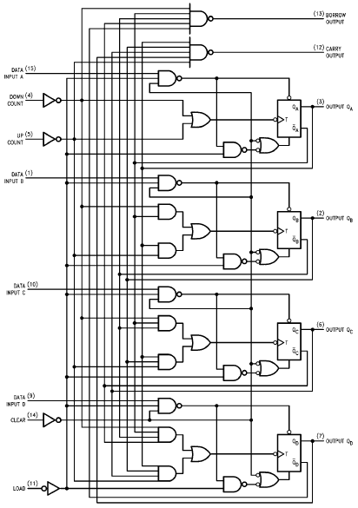
74LS193 Logic Diagram
Notes:
74LS193 logic diagrams from manufacturer’s datasheet. The students are not responsible for this material, but it is here just as a reference to show them the complexity of this MSI counter. Also, point out the all the clocks are tied together, that is why this is a synchronous counter design.

Slide 18
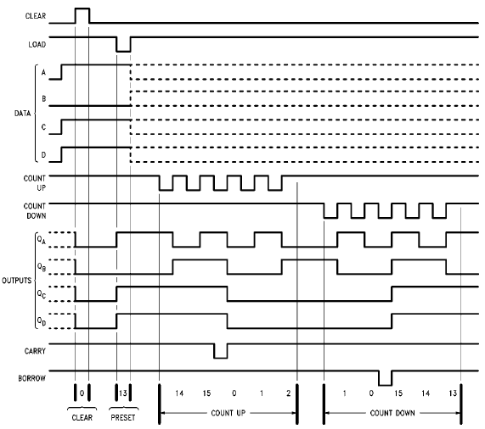
74LS193 Timing Diagram (1 of 3)
CLEAR set to a logic (1); Outputs are cleared immediately. CLEAR is an asynchronous input.
LOAD set to a logic (0); Outputs are loaded with input data immediately. In this case 13 (1101). LOAD is an asynchronous input.
A
B
Notes:
Shown is the composite timing diagram for the 74LS193 counter.

Slide 19
74LS193 Timing Diagram (2 of 3)
COUNT UP is clocked and COUNT DOWN is a logic (1). On every rising edge of clock, the output count is incremented by one. In this example 13, 14, 15, 0, 1, 2. Note, when the count is 15, CARRY is a logic (0) for ½ the clock cycle .
C
Notes:
Shown is the composite timing diagram for the 74LS193 counter.

Slide 20
74LS193 Timing Diagram (3 of 3)
COUNT DOWN is clocked and COUNT UP is a logic (1). On every rising edge of clock, the output count is decremented by one. In this example 2, 1, 0, 15, 14, 13. Note, when the count is 0, BORROW is a logic (0) for ½ the clock cycle .
D
Notes:
Shown is the composite timing diagram for the 74LS193 counter.

Slide 21
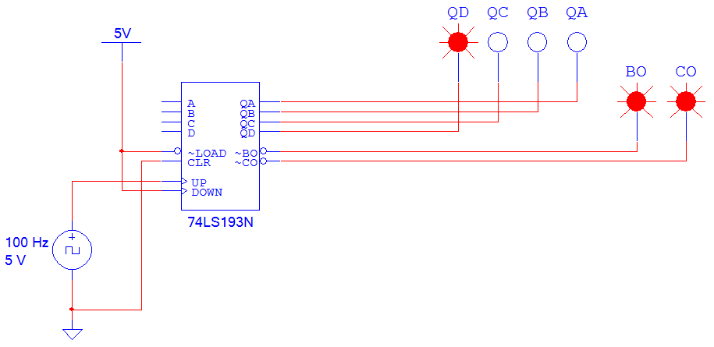
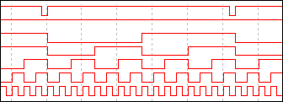
74LS193 Design Example #1
“C”
“D”
“E”
“F”
“0”
“1”
“2”
“3”
“4”
“5”
“6”
“7”
“8”
“9”
“A”
“B”
“C”
“D”
“E”
“F”
“0”
“1”
“2”
“3”
CO
BO
QD
QC
QB
QA
CLK
Repeats →
Notes:
In this example, the 74LS193 is setup as a free running up counter (i.e. no enable & no clear) from 0 to 15. Note that the CO is low when the count is F=15=1111.

Slide 22
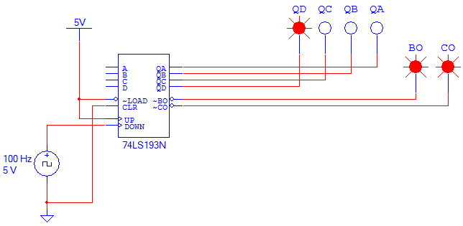
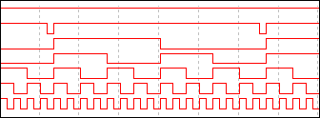
74LS193 Design Example #2
“3”
“2”
“1”
“0”
“F”
“E”
“D”
“C”
“B”
“A”
“9”
“8”
“7”
“6”
“5”
“4”
“3”
“2”
“1”
“0”
“F
“E”
“D”
“C”
Repeats →
CO
BO
QD
QC
QB
QA
CLK
Notes:
In this example, the 74LS193 is setup as a free running (i.e. no enable & no clear) down counter from 15 to 0. Note that the BO is low when the count is 0=0000.

Slide 23
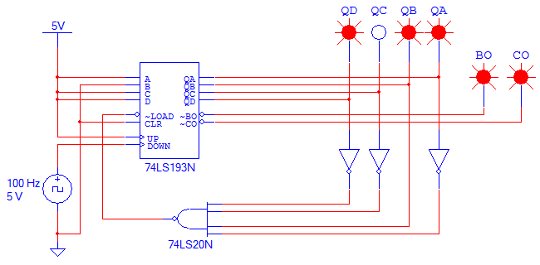
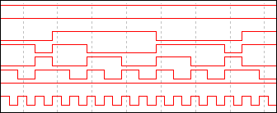
74LS193 Design Example #2
“5”
“4”
“3”
“D”
“C”
“B”
“A”
“9”
“8”
“7”
“6”
“5”
“4”
“3”
“D”
“C”
BO
CO
QD
QC
QB
QA
LOAD
CLK
Repeats →
Notes:
In this example, the 74LS193 is setup as a D (13) to 3 down counter.
Note, LOAD signal goes low when the count is 2 (0010). Because the LOAD signal is an asynchronous input, the output 2 (0010) is only at the output VERY briefly until the input data (D=13=1101) is loaded. The LOAD signal is low so briefly, it doesn’t even show on the waveform.

