Slide 1
Synchronous Counters
Digital Electronics
© 2014 Project Lead The Way, Inc.

Slide 2
Synchronous Counter
This presentation will
Define synchronous counters.
Provide examples of 3-Bit and 4-Bit synchronous up counters.
Provide examples of 3-Bit and 4-Bit synchronous down counters.
Notes:
Introductory Slide / Overview of Presentation

Slide 3
Synchronous Counters
All flip-flops are simultaneously clocked by an external clock.
Synchronous counters are faster than asynchronous counters at simultaneous clocking.
Synchronous counters do not suffer from the ripple effect that asynchronous counters do.
Synchronous counters require more logic than asynchronous counters.
Notes:
This slide provides the definition of synchronous counters.

Slide 4
3-Bit Synch Up Counter: Theory
 | 0 |  | 1 |  | 2 |  | 3 |  | 4 |  | 5 |  | 6 |  | 7 |  | 0
Q2
Q1
Q0
CLOCK
Q0 : Toggles On Falling Edge of CLOCK
Q1 : Toggles On Falling Edge of CLOCK & Q0=1
Q2 : Toggles On Falling Edge of CLOCK & Q0=1 & Q1=1
Notes:
Theory of operation of a 3-Bit Synchronous Up Counter.

Slide 5
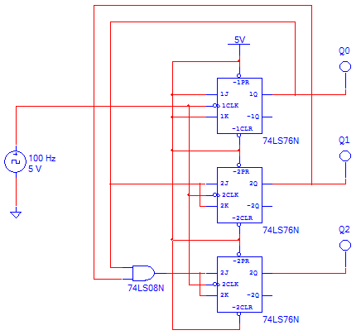
3-Bit Synch Up Counter: Circuit
Toggles On:
Falling Edge of CLOCK
Toggles On:
Falling Edge of CLOCK AND Q0=1
Toggles On:
Falling Edge of CLOCK AND Q0=1 & Q1=1
Notes:
3-Bit Synchronous Up Counter designed with J/K flip-flops.

Slide 6
3-Bit Synch Up Counter: Timing
“0”
“1”
“2”
“3”
“4”
“5”
“6”
“7”
Q2
Q1
Q0
CLK
Notes:
3-Bit Synchronous Up Counter timing diagram.

Slide 7
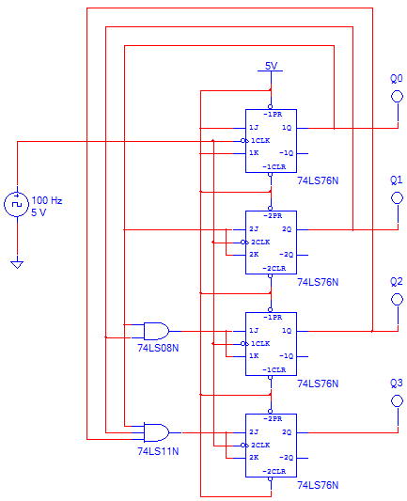
4-Bit Synch Up Counter: Circuit
Toggles On:
Falling Edge of CLOCK
Toggles On:
Falling Edge of CLOCK AND Q0=1
Toggles On:
Falling Edge of CLOCK AND Q0=1 & Q1=1
Toggles On:
Falling Edge of CLOCK AND Q0=1 & Q1=1 & Q2=1
Notes:
4-Bit Synchronous Up Counter designed with J/K flip-flops.

Slide 8
3-Bit Synch Down Counter: Theory
 | 7 |  | 6 |  | 5 |  | 4 |  | 3 |  | 2 |  | 1 |  | 0 |  | 7
Q2
Q1
Q0
CLOCK
Q0 : Toggles On Falling Edge of CLOCK
Q1 : Toggles On Falling Edge of CLOCK & Q0=0
Q2 : Toggles On Falling Edge of CLOCK & Q0=0 & Q1=0
Notes:
Theory of operation of a 3-Bit Synchronous Down Counter.

Slide 9
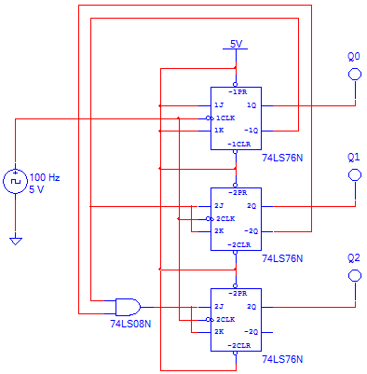
3-Bit Synch Down Counter: Circuit
Toggles On:
Falling Edge of CLOCK
Toggles On:
Falling Edge of CLOCK AND Q0=0
Toggles On:
Falling Edge of CLOCK AND Q0=0 & Q1=0
Notes:
3-Bit Synchronous Down Counter designed with J/K flip-flops.

Slide 10
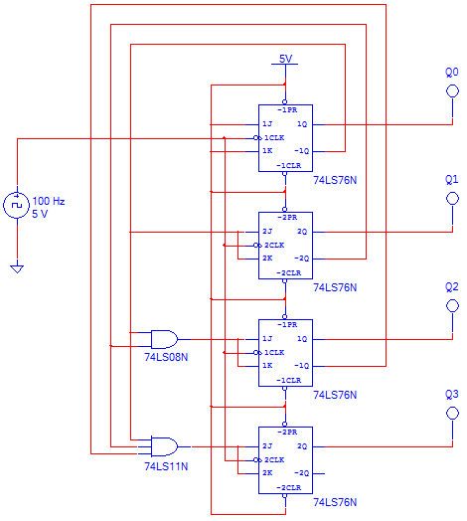
4-Bit Synch Down Counter: Circuit
Toggles On:
Falling Edge of CLOCK
Toggles On:
Falling Edge of CLOCK AND Q0=0
Toggles On:
Falling Edge of CLOCK AND Q0=0 & Q1=0
Toggles On:
Falling Edge of CLOCK AND Q0=0 & Q1=0 & Q2=0
Notes:
4-Bit Synchronous Down Counter designed with J/K flip-flops.

