Slide 1
Asynchronous Counters
with MSI Gates
Digital Electronics

Slide 2
Asynchronous MSI Counter
This presentation will
Introduce the 74LS93 4-Bit ripple counter.
Review the 74LS93’s block diagram, connection diagram, count sequence, and reset truth-table.
Provide an example of a counter application implemented with the 74LS93.
Discuss potential limitations of the 74LS93.
Notes:
Introductory Slide / Overview of Presentation

Slide 3
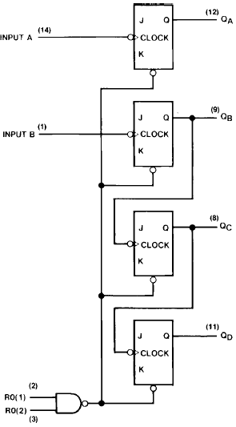
The 74LS93
The 74LS93 IC is a 4-Bit ripple counter partitioned into two sections.
The counter has a divide-by-two section and a divide-by-eight section.
Each section is triggered by a HIGH-to-LOW transition on the clock inputs.
Each section can be used separately or tied together.
The counters have a 2-input gated master reset (clear).
Note that the J&K inputs are connected to +5 volts (not shown).
Divide-By-Two
Section
Divide-By-Eight
Section
Notes:
Overview of the internal schematic diagram for the 74LS93 MSI 4-Bit Ripple Counter. Be sure to point out that the J&K inputs are tied to 5volts. This makes them all toggle flip-flops. They are not shown on the schematic for the sake of neatness.

Slide 4
The 74LS93 – Cascaded
Clock Input for
1-Bit Counter
The divide-by-two section can be used as a 1-Bit counter.
The divide-by-eight section can be used as a 3-Bit counter.
The divide-by-two and divide-by-eight sections can be cascaded to create a divide-by-sixteen circuit when a wire is added between Q_{A} and INPUT B.
The divide-by-sixteen circuit can be used as a 4-Bit counter.
1-Bit
Counter
Clock Input for
Cascaded
4-Bit Counter
Clock Input for
3-Bit Counter
3-Bit
Counter
Notes:
This slide shows how the 74LS03 can be used as a 1-Bit, 3-Bit, or 4-Bit counter. The connect that cascades the two sections together is an external wire that must be added.

Slide 5
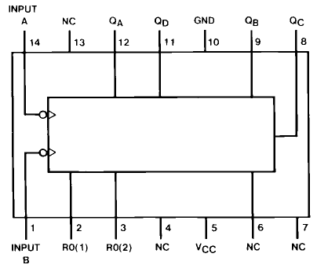
The 74LS93 MSI Counter
74LS93
Block Diagram
74LS93
Connection Diagram
Notes:
74LS93 Block Diagram & Connection Diagram. This is taken from the manufacturer datasheets.

Slide 6
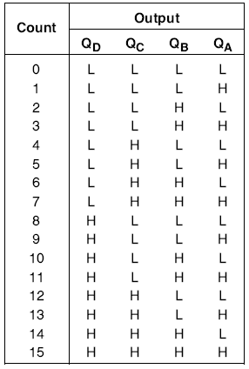
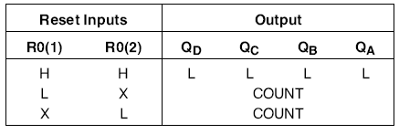
The 74LS93 MSI Counter
74LS93
Count Sequence
74LS93
Reset Truth Table
Notes:
74LS93 Count Sequence & Reset Truth Table. This is taken from the manufacturer datasheets.

Slide 7
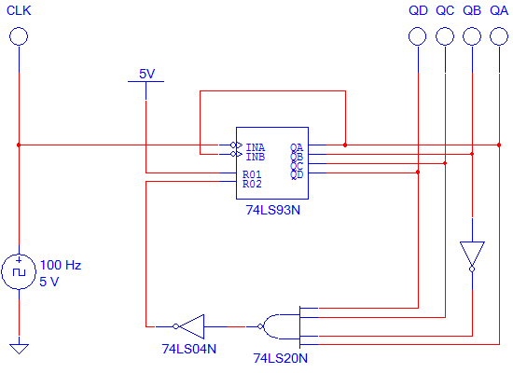
Design Example: Circuit Diagram
4-Bit Asynchronous / Modulus-13 Counter
To reset @ 12 (1100), the count must reach 13 (1101).
Notes:
Design Example. Because the resets (RO1 & R02) are asynchronous, the count must go one past the desired count limit. In this case the design count limit is 12 (1100), so the reset event is a 13 (1101).

Slide 8
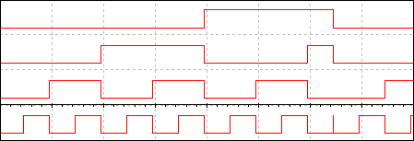
Design Example: Timing
4-Bit Asynchronous
Modulus-13 Counter
“0”
“1”
“2”
“3”
“4”
“5”
“6”
“7”
“8”
“9”
“A”
“B”
“C”
“0”
QD
0
0
0
0
0
0
0
0
1
1
1
1
1
0
QC
0
0
0
0
1
1
1
1
0
0
0
0
1
0
Repeats →
QB
0
0
1
1
0
0
1
1
0
0
1
1
0
0
QA
0
1
0
1
0
0
0
1
0
1
0
1
0
0
Notes:
Design example timing diagram. Point out the glitch on QA after the count of 12 (1100). This is the counter going to 13 (1101) and causing the reset circuit to reset the counter back to 0 (0000).

Slide 9
The 74LS93 – Limitation
As with most MSI integrated circuits, the trade-off for the convenience of an all-in-one package is the lack of design flexibility.
This lack of flexibility may lead to limitation or inability to use the IC in certain applications.
The primary limitations of the 74LS93 are:
The flip-flops are not pre-settable; thus, the count must always start at zero.
As designed, it can only be used to implement up counts.
If your design calls for an up-counter that starts at zero, the 74LS93 is the ideal IC.
Notes:
Review the potential limitation of the 74LS93. Summarize by telling the students that the 74LS93 was designed to serve a specific need. If its specifications meet their need, it is a great chip to use. Otherwise they need to use discrete gates.

