Slide 1
Component Identification: Digital
Introduction to Logic Gates and Integrated Circuits
Digital Electronics
© 2014 Project Lead The Way, Inc.

Slide 2
This presentation will..
Introduce transistors, logic gates, integrated circuits (ICs), and explain the relationship of each.
Describe the structure of a truth table and how to “count in binary”. (possible input combinations)
Present an overview of :
  Transistor-Transistor Logic – TTL
  Complementary Metal Oxide Semiconductor - CMOS
Define the scale of integration and package styles.
Describe the TTL logic gate numbering system.
Introduce Manufacturer Datasheets.
Notes:
Introductory Slide / Overview of Presentation

Slide 3
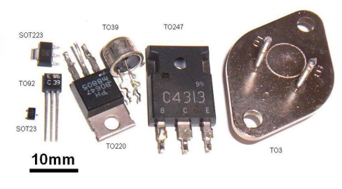
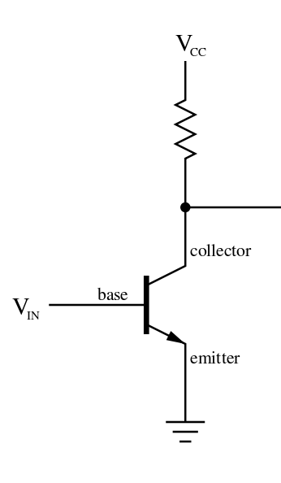
Transistors to Gates
Transistor
An electronic device that is used to control the flow of electricity in electronic equipment with at least three electrodes. A small voltage controls a larger voltage.
Can act as an amplifier.
Can act as a switch.
  Completely off or completely on.
Notes:
Introductory Slide / Overview of Presentation

Slide 4
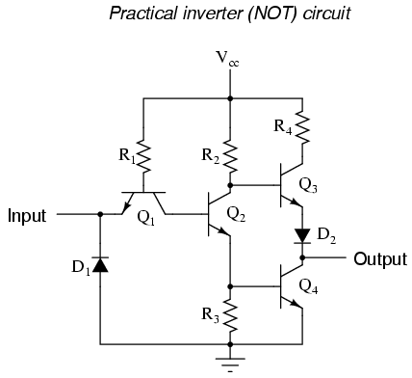


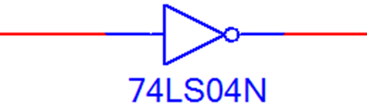
Transistors to Gates
Gates
Transistors and resistors can be arranged to create desired outputs base on specific inputs. (Logic Gates)
Because transistors have only two states (on or off), binary number systems and Boolean Algebra are used to describe the relationship of inputs to outputs on these gates.
These input to output relationships can be shown on what are called truth tables.
Notes:
Introductory Slide / Overview of Presentation

Slide 5
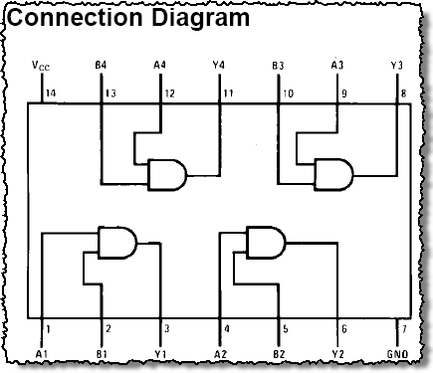
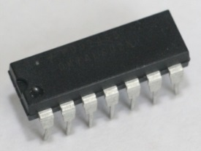
Gates to Integrated Circuits (ICs)
Integrated Circuit
An electronic circuit having many components, such as transistors, diodes, resistors, and capacitors in a single package.
Transistors Gates Integrated Circuits
Notes:
In order to understand the ascending order of the truth table, students will need to learn about the binary number system and “how to count to three” in binary. We will do this in a later activity.

Slide 6
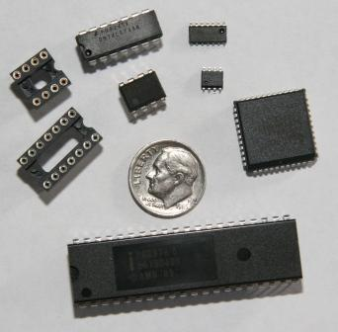
Common Electronic Components
Integrated Circuits (IC’s) & Sockets
8 Pin Solder Socket
14 Pin Solder Socket
14 Pin DIP IC
8 Pin DIP IC
40 Pin DIP
14 PIN SOIC
8 Pin SOIC
44 Pin PLCC
3
6
7
1
4
8
2
5
DIP – Dual Inline Package
SOIC – Small Outline Integrated Circuit
PLCC - Plastic Leaded Chip Carrier

Slide 7
Gates and Truth Tables
Truth Tables
A list of all possible input values to a digital circuit, listed in ascending binary order, and the output response for each input combination.
Inputs X and Y might be buttons or switches.
Output Z might be a buzzer or LED.
For 2 inputs there can only be 4 possible arrangements of the inputs (switches).
Input X | Input Y | Output Z
0 | 0 | ?
0 | 1 | ?
1 | 0 | ?
1 | 1 | ?
Notes:
In order to understand the ascending order of the truth table, students will need to learn about the binary number system and “how to count to three” in binary. We will cover binary number systems in greater detail later.

Slide 8
Truth Tables and Binary
Interpreting a Truth Table
In order to understand the structure of a truth table, it is helpful to understand how to count in binary (Base 2 number system).
The ascending rows in this truth table represent a count of (0-3) in the binary number system if you look at inputs X and Y together.
We will learn to count in binary later.
Input X | Input Y | Output Z
0 | 0 | ?
0 | 1 | ?
1 | 0 | ?
1 | 1 | ?
0
1
2
3
Notes:
In order to understand the ascending order of the truth table, students will need to learn about the binary number system and “how to count to three” in binary.

Slide 9

Truth Tables and Binary
For this activity in is only important to know that the truth table is showing is all possible output responses for each input combination. (2 inputs = 4 possible outputs)
All possible input values to a digital circuit are listed in ascending binary order on the truth table.
We will explore the binary number system in detail and how to create your own truth tables in future activities.
Notes:
In order to understand the ascending order of the truth table, students will need to learn about the binary number system and “how to count to three” in binary. We will do this in a later activity.

Slide 10
Introduction to Integrated Circuits
All logic gates are available in Integrated Circuits (ICs)
ICs are categorized in three different ways:
  The underlying technology upon which their circuitry is based:
    Transistor-Transistor Logic - TTL
    Complementary Metal Oxide Semiconductor - CMOS
  The scale of integration:
    Small Scale Integration - SSI
    Medium Scale Integration - MSI
    Large Scale Integration - LSI
    Very Large Scale Integration - VLSI
  Package Style
    Through-Hole Technology - THT
      Dual Inline Packages - DIP
    Surface-Mount Technology - SMT
      Small Outline IC - SOIC
      Plastic Leaded Chip Carrier - PLCC
      Quad Flat Pack - QFP
Notes:
This slide gives a brief overview integrated circuits and how they are categorized. This slide is filled with TLA (Three Letter Acronyms), many of which the students will become fluent with by the end of this course.

Slide 11

TTL vs. CMOS
TTL: Transistor-Transistor Logic
Constructed from Bipolar Junction Transistors (BJT)
Advantages:
  Faster than CMOS
  Not sensitive to damage from electrostatic-discharge
Disadvantages:
  Uses more power than CMOS
CMOS: Complementary Metal Oxide Semiconductor
Constructed from Metal Oxide Semiconductor
Field-Effect Transistors (MOSFET)
Advantages:
  Uses less power than TTL
Disadvantages:
  Slower than TTL
  Very sensitive to damage from electrostatic-discharge
BJT
Transistor
MOSFET
Transistor
Notes:
This slide defines TTL & CMOS and gives the advantages & disadvantages of each.
We will primarily use TTL logic gates throughout this course.

Slide 12
IC Density of Integration
Density of Integration / Complexity | Gates per IC
SSI: Small-Scale Integration Logic Gates (AND, OR, NAND, NOR) | <10
MSI: Medium-Scale Integration Flip Flops Adders / Counters Multiplexers & De-multiplexers | 10 – 100
LSI: Large-Scale Integration Small Memory Chips Programmable Logic Device | 100 – 10,000
VLSI: Very Large-Scale Integration Large Memory Chips Complex Programmable Logic Device | 10,000 – 100,000
ULSI: Ultra Large-Scale Integration 8 & 16 Bit Microprocessors | 100,000 – 1,000,000
GSI: Giga-Scale Integration Pentium IV Processor | >1,000,000
Notes:
This slide defines SSI, MSI, LSI, VLSI, ULSI, & GSI and give gates counter per IC density range for each.
We will primarily use SSI & MSI logic gates throughout this course.

Slide 13

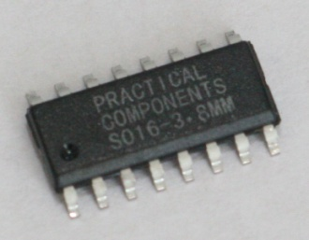
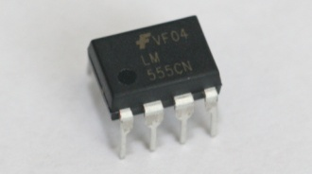
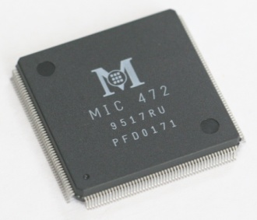
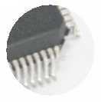
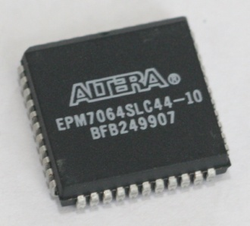
Package Styles
    Through-Hole Technology
    (THT)
    Surface Mount Technology
    (SMT)
DIP: Dual Inline Package
SOIC: Small Outline IC
QFP: Quad Flat Pack
NOTE: For most commercial application, the DIP package has become obsolete. However, it is still the package of choice for educational applications because it can be used with protoboards.
PLCC: Plastic Leaded Chip Carrier
Notes:
This slide gives an overview of both the Through-Hole Technology and Surface-Mount Technology packages styles.
We will primarily use THT – DIP packages throughout this course.

Slide 14
Through-Hole Technology (THT)
THT components have pins that are inserted into holes drilled in the PCB and soldered on the reverse side of the board.
Advantages:
  Designs with THT components are easier to hand-assemble than SMT-based designs because THT components are much larger.
  THT components can be used in proto-boards.
Disadvantages:
  Designs with THT components are significantly larger than SMT-based designs.
  Most high-end electronics components (i.e., microprocessors) are not available in THT package styles.
Notes:
This slide defines the THT package style and gives the advantages and disadvantage of each.

Slide 15
Surface Mount Technology (SMT)
SMT components are mounted on the surface of the PCB, so no holes need to be drilled.
Primary Advantages:
  Designs with SMT components are smaller than THT-based designs because SMT components are significantly smaller and have much higher pin counts than THT components.
  Also, SMT components can be mounted on both sides of the PCB.
Primary Disadvantages:
  Designs with SMT components are more expensive to manufacture because the process is significantly more sophisticated than THT-based designs.
  SMT components can not be used in a proto-boarding.
Notes:
This slide defines the SMT package style and gives the advantages and disadvantage of each.

Slide 16
TTL Logic Sub-Families
TTL Series | Infix | Example | Comments
Standard TTL | none | 7404 | Original TTL gates. Slowest, uses a lot of power. (obsolete)
Low Power | L | 74L04 | Optimized to consume less power than "Standard". (obsolete)
Schottky | S | 74S04 | First to utilizes the Schottky transistor. Optimized for speed, but consumes a lot of power. (obsolete)
Low-Power Schottky | LS | 74LS04 | Faster and lower power consumption than the L & S subfamilies. The type that is used throughout this course.
Advanced Schottky | AS | 74A S04 | Very fast, uses a lot of power.
Advanced Low-Power Schottky | ALS | 74ALS04 | Very good speed-power ratio. Quite popular member of this family.
Notes:
This slide defines all TTL Logic Sub-Families.
We will primarily use the LS sub-family throughout this course.

Slide 17
TTL Logic Gate Numbering System
DM 74 LS 08 N
Package Style (i.e., N=DIP)
Logic Function (i.e., 04 = Inverter, 08 = AND Gate, etc.)
Logic Sub-family (i.e., LS = Low Power Schottky)
74-Series TTL
Manufacturer
  DM = Fairchild Semiconductor
  SN = Texas Instruments
Notes:
This slide describes the numbering system used to label TTL Logic Gates.

Slide 18
Manufacturer Datasheets
A manufacturer datasheet for a logic gate contains the following information:
General Description
Connection (pin-out) Diagram
Function Table
Operating Conditions
Electrical Characteristics
Switching Characteristics
Physical Dimensions
Notes:
This slide gives a brief overview of the information that is contained in a manufacturer datasheet for a TTL logic gate.

Slide 19
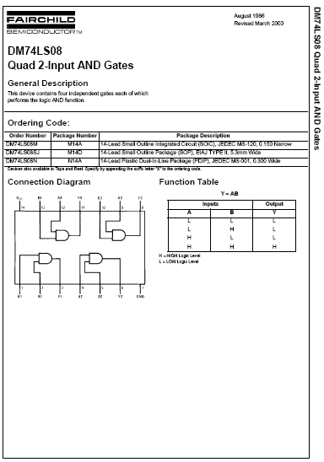
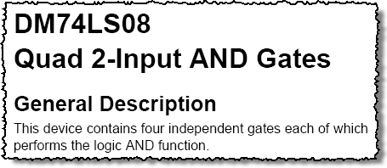
General Description
Notes:
The General Description is found on the first page of a data sheet.
The first page of the data sheet will contain a general description of what the logic gate does, a connection diagram that shows how the gates are connected to the pins, and a function table the describes what the individual gates do in a in tabular form.
For the most part, the first page of the datasheet contains all of the information that we will be using in this course.

Slide 20
Connection Diagram
Notes:
The Connection Diagram is found on the first page of a data sheet.
The first page of the data sheet will contain a general description of what the logic gate does, a connection diagram that shows how the gates are connected to the pins, and a function table the describes what the individual gates do in a in tabular form.

Slide 21
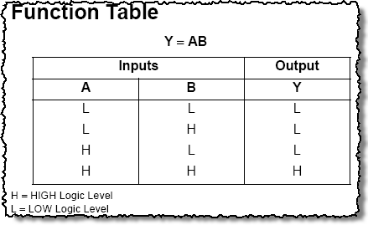
Function Table
Notes:
The Function Table is found on the first page of a data sheet.
The first page of the data sheet will contain a general description of what the logic gate does, a connection diagram that shows how the gates are connected to the pins, and a function table the describes what the individual gates do in a in tabular form.
For the most part, the first page of the datasheet contains all the information that we will be using in this course.

Slide 22
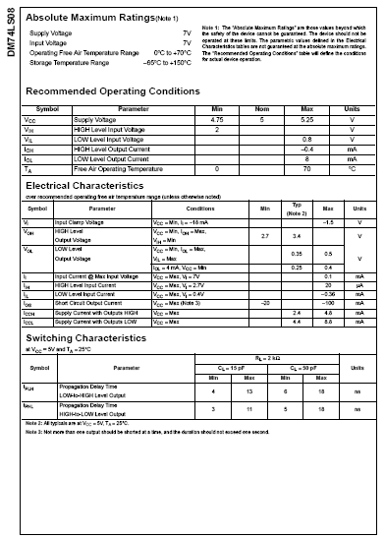
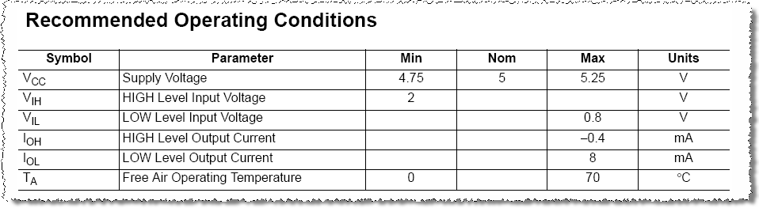
Recommended Operating Conditions
Notes:
The Recommended Operating Conditions, Electrical Characteristics, and Switching Characteristics sections detail the minimum, maximum, and typical values for various voltage, current, and timing parameters for this IC.

Slide 23
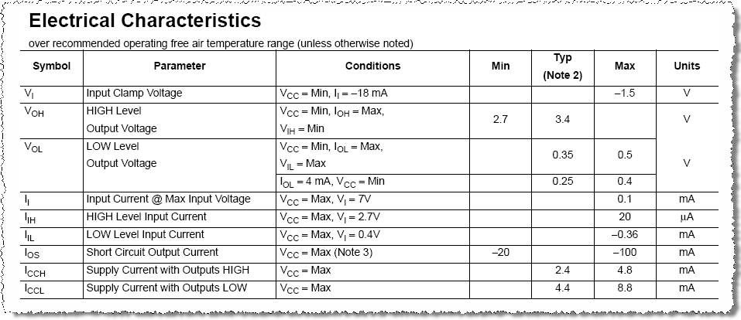
Electrical Characteristics
Notes:
The Recommended Operating Conditions, Electrical Characteristics, and Switching Characteristics sections detail the minimum, maximum, and typical values for various voltage, current, and timing parameters for this IC.

Slide 24
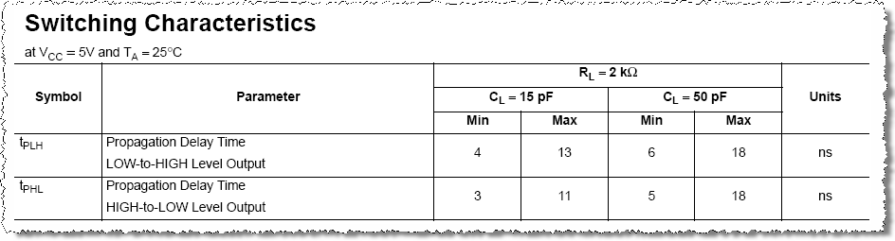
Switching Characteristics
Notes:
The Recommended Operating Conditions, Electrical Characteristics, and Switching Characteristics sections detail the minimum, maximum, and typical values for various voltage, current, and timing parameters for this IC.

Slide 25
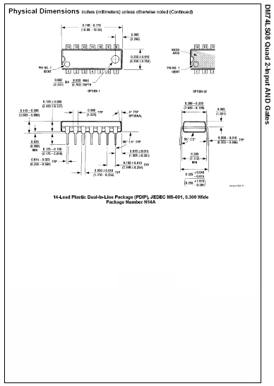
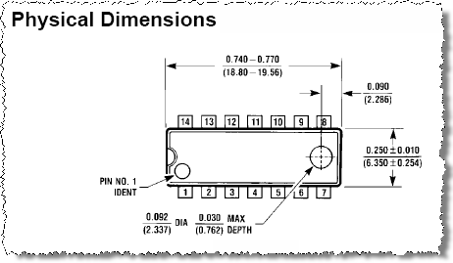
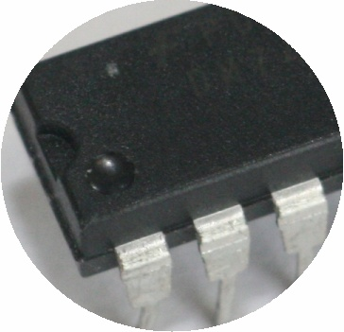
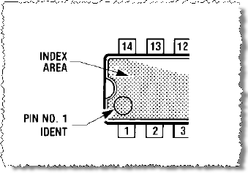
Physical Dimensions
Notes:
The Physical Dimensions section give detailed measurements for each IC package style for which the part is available. This information is used by PCB board designers when they lay out a design that uses this IC. The Physical Dimensions section is typically found at the end of the data sheet.

