Slide 1
Circuit Theory Laws
Digital Electronics
© 2014 Project Lead The Way, Inc.

Slide 2
Circuit Theory Laws
This presentation will
Review voltage, current, and resistance.
Review and apply Ohm’s Law.
Review series circuits.
  Current in a series circuit
  Resistance in a series circuit
  Voltage in a series circuit
Review and apply Kirchhoff’s Voltage Law.
Review parallel circuits.
  Current in a parallel circuit
  Resistance in a parallel circuit
  Voltage in a parallel circuit
Review and apply Kirchhoff’s Current Law.
Notes:
Introductory Slide / Overview of Presentation

Slide 3
Electricity – The Basics
An understanding of the basics of electricity requires the understanding of three fundamental concepts.
Voltage
Current
Resistance
A direct mathematical relationship exists between voltage, resistance, and current in all electronic circuits.
Notes:
Introduction to the three basic elements of electricity/electronics

Slide 4
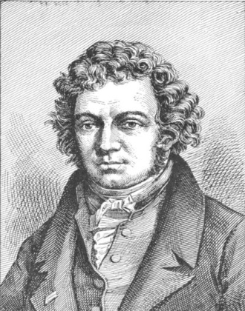
Voltage, Current, & Resistance
Current – Current is the flow of electrical charge through an electronic circuit. The direction of a current is opposite to the direction of electron flow. Current is measured in AMPERES (AMPS).
Andre Ampere
1775-1836
French Physicist
Notes:
The formal definition of current and the scientist that bears their name.
http://commons.wikimedia.org/wiki/Image:Andre-marie-ampere2.jpg

Slide 5
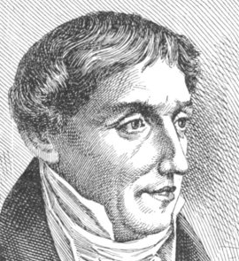
Voltage
Voltage – Voltage is the electrical force that causes current to flow in a circuit. It is measured in VOLTS.
Alessandro Volta
1745-1827
Italian Physicist
Notes:
The formal definition of voltage and the scientist that bears their name.
http://commons.wikimedia.org/wiki/Image:Alessandro_volta2.jpg

Slide 6
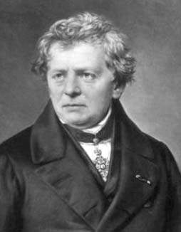
Resistance
Resistance – Resistance is a measure of opposition to current flow. It is measured in Ohms.
Georg Simon Ohm
1789-1854
German Physicist
Notes:
The formal definition of resistance and the scientist that bears their name.
http://commons.wikimedia.org/wiki/Image:Ohm3.gif

Slide 7
First, An Analogy
The flow of water from one tank to another is a good analogy for an electrical circuit and the mathematical relationship between voltage, resistance, and current.
Force: The difference in the water levels ≡ Voltage
Flow: The flow of the water between the tanks ≡ Current
Opposition: The valve that limits the amount of water ≡ Resistance
Force
Flow
Opposition
Notes:
The classic water analogy for voltage/current/resistance.

Slide 8
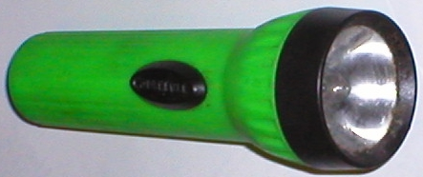
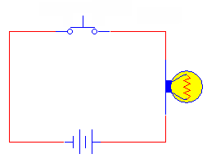
Anatomy of a Flashlight
Switch
Switch
Light
Bulb
Light
Bulb
D - Cell
Battery
- +
Battery
Block Diagram
Schematic Diagram
Notes:
This slide shows an everyday object (flashlight), its block diagram, and the equivalent schematic.
http://commons.wikimedia.org/wiki/Image:Flashlight_450x190_commons.jpg

Slide 9
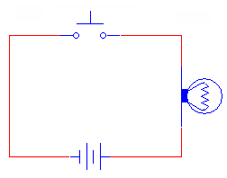
Flashlight Schematic
Current
Resistance
- +
- +
Voltage
Closed circuit (switch closed)
Current flow
Lamp is on
Lamp is resistance, uses energy to produce light (and heat)
Open circuit (switch open)
No current flow
Lamp is off
Lamp is resistance, but is not using any energy
Notes:
This slide shows the flow of electrons (not really; it’s the flow of current . . . see the next slide) when the switch closed.

Slide 10
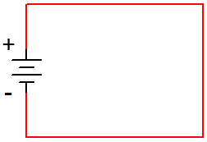
Current Flow
Conventional Current assumes that current flows out of the positive side of the battery, through the circuit, and back to the negative side of the battery. This was the convention established when electricity was first discovered, but it is incorrect!
Electron Flow is what actually happens. The electrons flow out of the negative side of the battery, through the circuit, and back to the positive side of the battery.
Conventional
Current
Electron
Flow
Notes:
Conventional Current vs. Electron Flow (Scientists vs. Engineers – since this is an engineering course, guess who wins?).

Slide 11
Engineering vs. Science
The direction that the current flows does not affect what the current is doing; thus, it doesn’t make any difference which convention is used as long as you are consistent.
Both Conventional Current and Electron Flow are used. In general, the science disciplines use Electron Flow, whereas the engineering disciplines use Conventional Current.
Since this is an engineering course, we will use Conventional Current.
Electron
Flow
Conventional
Current
Notes:
Of course, the engineers win!

Slide 12

Ohm’s Law
Defines the relationship between voltage, current, and resistance in an electric circuit
Ohm’s Law:
    Current in a resistor varies in direct proportion to the voltage applied to it and is inversely proportional to the resistor’s value.
Stated mathematically:
V
+ -
I
R
  Where: I is the current (amperes)
  V is the potential difference (volts)
  R is the resistance (ohms)
Notes:
Introduction to Ohm’s Law

Slide 13
Ohm’s Law Triangle
V
I
R
V
I
R
V
I
R
Notes:
Ohm’s Law Triangle – Place your finger over the unknown quantity and what remains is the equation used to solve for the unknown.

Slide 14
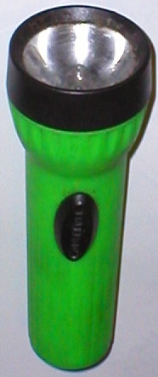
Example: Ohm’s Law
Example:
  The flashlight shown uses a 6 volt battery and has a bulb with a resistance of 150 Ω. When the flashlight is on, how much current will be drawn from the battery?
Notes:
Pause the presentation and allow the student to work on the example. The solution is on the next slide.

Slide 15
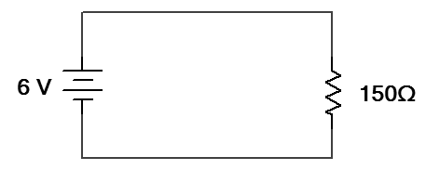
Example: Ohm’s Law
Example:
  The flashlight shown uses a 6 volt battery and has a bulb with a resistance of 150 Ω. When the flashlight is on, how much current will be drawn from the battery?
Solution:
Schematic Diagram
I_{R}
+
-
V
V_{T} =
V_{R}
I
R
Notes:
This slide provides the solution. If you print handouts, do not print this page.

Slide 16
Circuit Configuration
Components in a circuit can be connected in one of two ways.
Series Circuits
Components are connected end-to-end.
There is only a single path for current to flow.
Parallel Circuits
Both ends of the components are connected together.
There are multiple paths for current to flow.
Components
(i.e., resistors, batteries, capacitors, etc.)
Notes:
Overview of series and parallel component configuration.

Slide 17
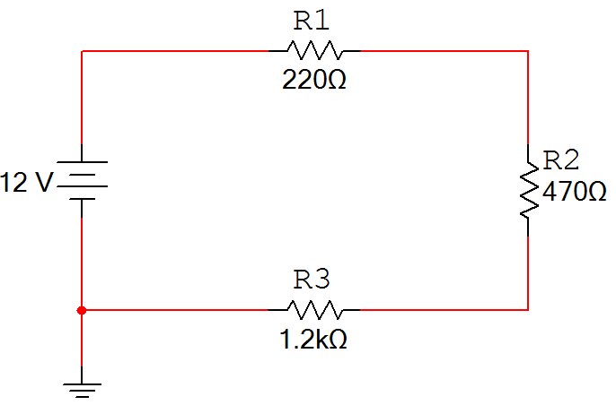
Series Circuits
Characteristics of a series circuit
The current flowing through every series component is equal.
The total resistance (R_{T}) is equal to the sum of all of the resistances (i.e., R₁ + R₂ + R₃).
The sum of all of the voltage drops (V_{R1} + V_{R2} + V_{R2}) is equal to the total applied voltage (V_{T}). This is called Kirchhoff’s Voltage Law.
V_{R1}
I_{T}
+
-
+
+
V_{T}
V_{R2}
-
-
R_{T}
-
+
V_{R3}
Notes:
Characteristics of a series circuit.

Slide 18
Example: Series Circuit
Example:
  For the series circuit shown, use the laws of circuit theory to calculate the following:
    The total resistance (R_{T})
    The current flowing through each component (I_{T}, I_{R1}, I_{R2}, and I_{R3})
    The voltage across each component (V_{T}, V_{R1}, V_{R2}, and V_{R3})
    Use the results to verify Kirchhoff’s Voltage Law.
V_{R1}
I_{T}
+
-
+
I_{R1}
+
V_{T}
I_{R2}
V_{R2}
-
I_{R3}
-
R_{T}
-
+
V_{R3}
Notes:
Pause the presentation and allow the student to work on the example. The solution is on the next three slides.

Slide 19
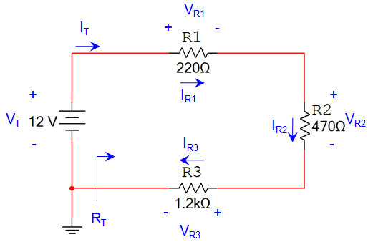
Example: Series Circuit
Solution:
Total Resistance:
Current Through Each Component:
V
I
R
Notes:
This slide provides the solution. If you print handouts, don’t print this page. (1 of 3)

Slide 20
Example: Series Circuit
Solution:
Voltage Across Each Component:
V
I
R
Notes:
This slide provides the solution. If you print handouts, don’t print this page. (2 of 3)

Slide 21
Example: Series Circuit
Solution:
Verify Kirchhoff’s Voltage Law:
Notes:
This slide provides the solution. If you print handouts, don’t print this page. (3 of 3)

Slide 22
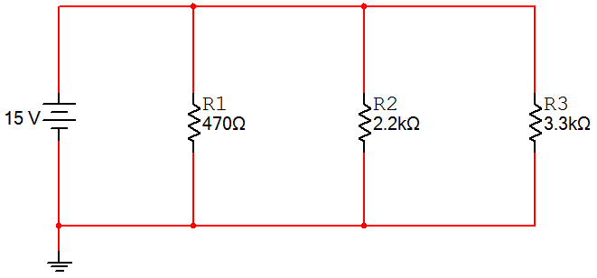
Parallel Circuits
Characteristics of a Parallel Circuit
The voltage across every parallel component is equal.
The total resistance (R_{T}) is equal to the reciprocal of the sum of the reciprocal:
The sum of all of the currents in each branch (I_{R1} + I_{R2} + I_{R3}) is equal to the total current (I_{T}). This is called Kirchhoff’s Current Law.
I_{T}
+
+
+
+
V_{T}
V_{R1}
V_{R2}
V_{R3}
-
-
-
-
R_{T}
Notes:
Characteristics of a parallel circuit.

Slide 23
Example: Parallel Circuit
Example:
  For the parallel circuit shown, use the laws of circuit theory to calculate the following:
    The total resistance (R_{T})
    The voltage across each component (V_{T}, V_{R1}, V_{R2}, and V_{R3})
    The current flowing through each component (I_{T}, I_{R1}, I_{R2}, and I_{R3})
    Use the results to verify Kirchhoff’s Current Law.
I_{T}
I_{R1}
I_{R2}
I_{R3}
+
+
+
+
V_{T}
V_{R1}
V_{R2}
V_{R3}
-
-
-
-
23
R_{T}
Notes:
Pause the presentation and allow the student to work on the example. The solution is on the next three slides.

Slide 24
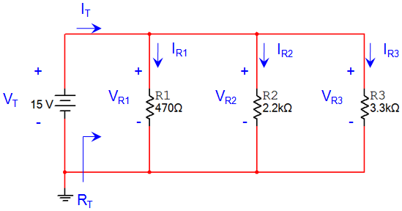
Example: Parallel Circuit
Solution:
Total Resistance:
Voltage Across Each Component:
Notes:
This slide provides the solution. If you print handouts, don’t print this page. (1 of 3)

Slide 25
Example: Parallel Circuit
Solution:
Current Through Each Component:
V
I
R
Notes:
This slide provides the solution. If you print handouts, don’t print this page. (2 of 3)

Slide 26
Example: Parallel Circuit
Solution:
Verify Kirchhoff’s Current Law:
Notes:
This slide provides the solution. If you print handouts, don’t print this page. (3 of 3)

Slide 27
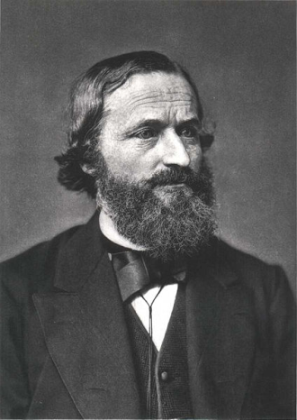
Summary of Kirchhoff’s Laws
Kirchhoff’s Voltage Law (KVL):
  The sum of all of the voltage drops in a series circuit equals the total applied voltage.
Kirchhoff’s Current Law (KCL):
  The total current in a parallel circuit equals the sum of the individual branch currents.
Gustav Kirchhoff
1824-1887
German Physicist
Notes:
Summary of Kirchhoff’s Laws.
http://commons.wikimedia.org/wiki/Image:Gustav_Robert_Kirchhoff.jpg

